Slide 1
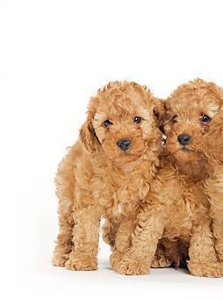
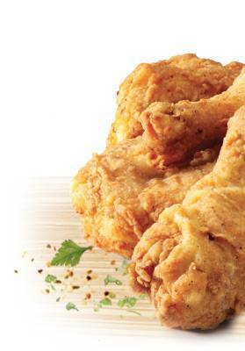
Pups or Poultry?
Group 3

Slide 2
Methodology
Baseline model: Select best features
Feature | Model | Accuracy (CV = 5-fold) | Timing | Accuracy/Timing
SIFT (depth = 1, trees = 2000) | GBM | 66.25% | 3351 | 0.000197702
SIFT (depth =3, trees = 2000) | GBM | 67% | 3351 | 0.00019994
SIFT (depth = 5, trees = 1955) | GBM | 69% | 3351 | 0.000205909
SIFT + Color (depth =1, , trees = 2000) | GBM | 78% | 5800 | 0.000134483
SIFT + Color (depth =3, trees = 1927) | GBM | 78% | 5800 | 0.000134483
SIFT + Color (depth = 5, trees = 1205) | GBM | 78.35% | 5800 | 0.000135086
SURF + Color (depth =1, trees = 2000) | GBM | 80.25% | 3759 | 0.000213488
SURF + Color (depth =3, trees = 1831) | GBM | 79.25% | 3759 | 0.000210827
SURF + Color (depth =5, trees = 1212) | GBM | 81.75% | 3759 | 0.000217478
Best features: Select best model
Feature | Model | Accuracy (CV = 5-fold) | Timing | Accuracy/Timing
SURF + Color | Linear Kernel SVM (cost = 10) | 79% | 154 | 0.00512987
SURF + Color | Radial Kernel SVM (cost = 10, gamma = 10) | 80% | 625 | 0.00128
SURF + Color (depth =5) | GBM | 81.75% | 3759 | 0.000217478

Slide 3
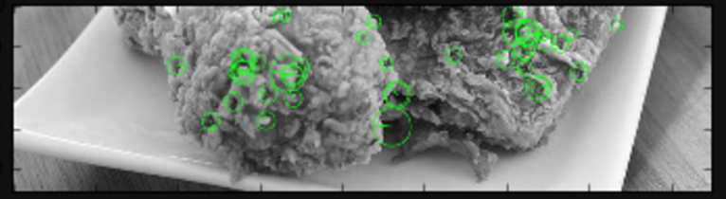
Features: SURF
Speeded Up Robust Features
Inspired by SIFT
MiniBatchK-means with 5500 centroids

Slide 4
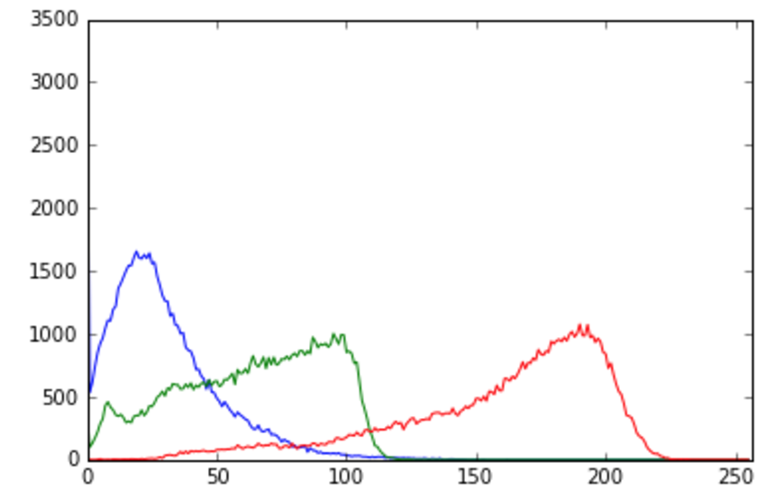
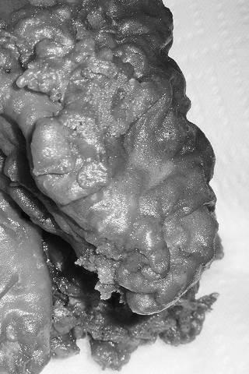
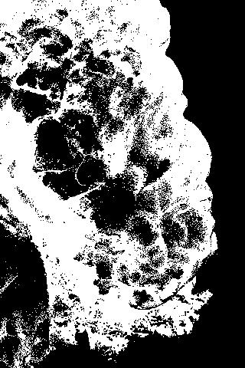
Features: Color Distribution
By applying binary threshold on the image, we approximately regard all the area in black as background and exclude it from future calculation of color distribution.
Here we get the distribution of color index distribution on both R,G,B scale, and use it as additional feature to SURF.

Slide 5
Models
Baseline Model: GBM
SVM
Linear kernel
Radial kernel

